Slide 1

HCI - Assignment n.2
Design and prototyping of an application using a human-centered approach
Deliverable n. 1: Requirement Analysis
Project Title: Barking App, an application for the Barking Veterinary Clinic
Group: Marta Condeço 112903
Henrique Oliveira 113515
João Gaspar 114514
Lab Class: P6
HCI 2023-2024

Slide 2
Introduction
Barking App
Motivation
Will more effectively connect the bridge between owner-veterinarian, by making it easier for both parties to find, organize and manage the information regarding the owners' pets.
Vet – Escape the current method of handling the pets' info (excel) for a better method (purpose-driven designed web app)
Why this project
This app was requested by Henrique to improve quality-of-life of her sister-in-law who’s a veterinarian and thought there was room for improvement in her workplace to better match hers and her clients' wants and needs.
Personal Interests
We mean to connect this project with Database course to make a fully functional app for real-world deployment
HCI 2023-2024
2

Slide 3
Project Objectives
Barking App
High-level Goals:
Allow owners to access their pet's health data and appointments
Give the veterinarian an effective tunnel of communication with their clients
Allow owners to check the status of a process related to their pet
Expected outcomes
Connect thoroughly the client and the veterinarian
Benefits
Allow pet owners to have all the information to better take care of their pet at their fingertip.
Alongside with a stronger veterinarian way of giving information
HCI 2023-2024
3

Slide 4

Personas
Barking App
Name | Dr. Daniela
Gender | Female
Age | 29 years
Profession | Veterinarian
Background | Dr. Daniela is a young veterinarian who has great knowledge over technologies
Main motivation and goals | Dr. Daniela needs to give and retrieve inteligence on her client’s pets, to provide a better care for them.
Needs | Dr. Daniela is in need of an effective method to pass information to her clientes such that they can’t garble information they shouldn’t, and provide a more attentive service
HCI 2023-2024
4

Slide 5
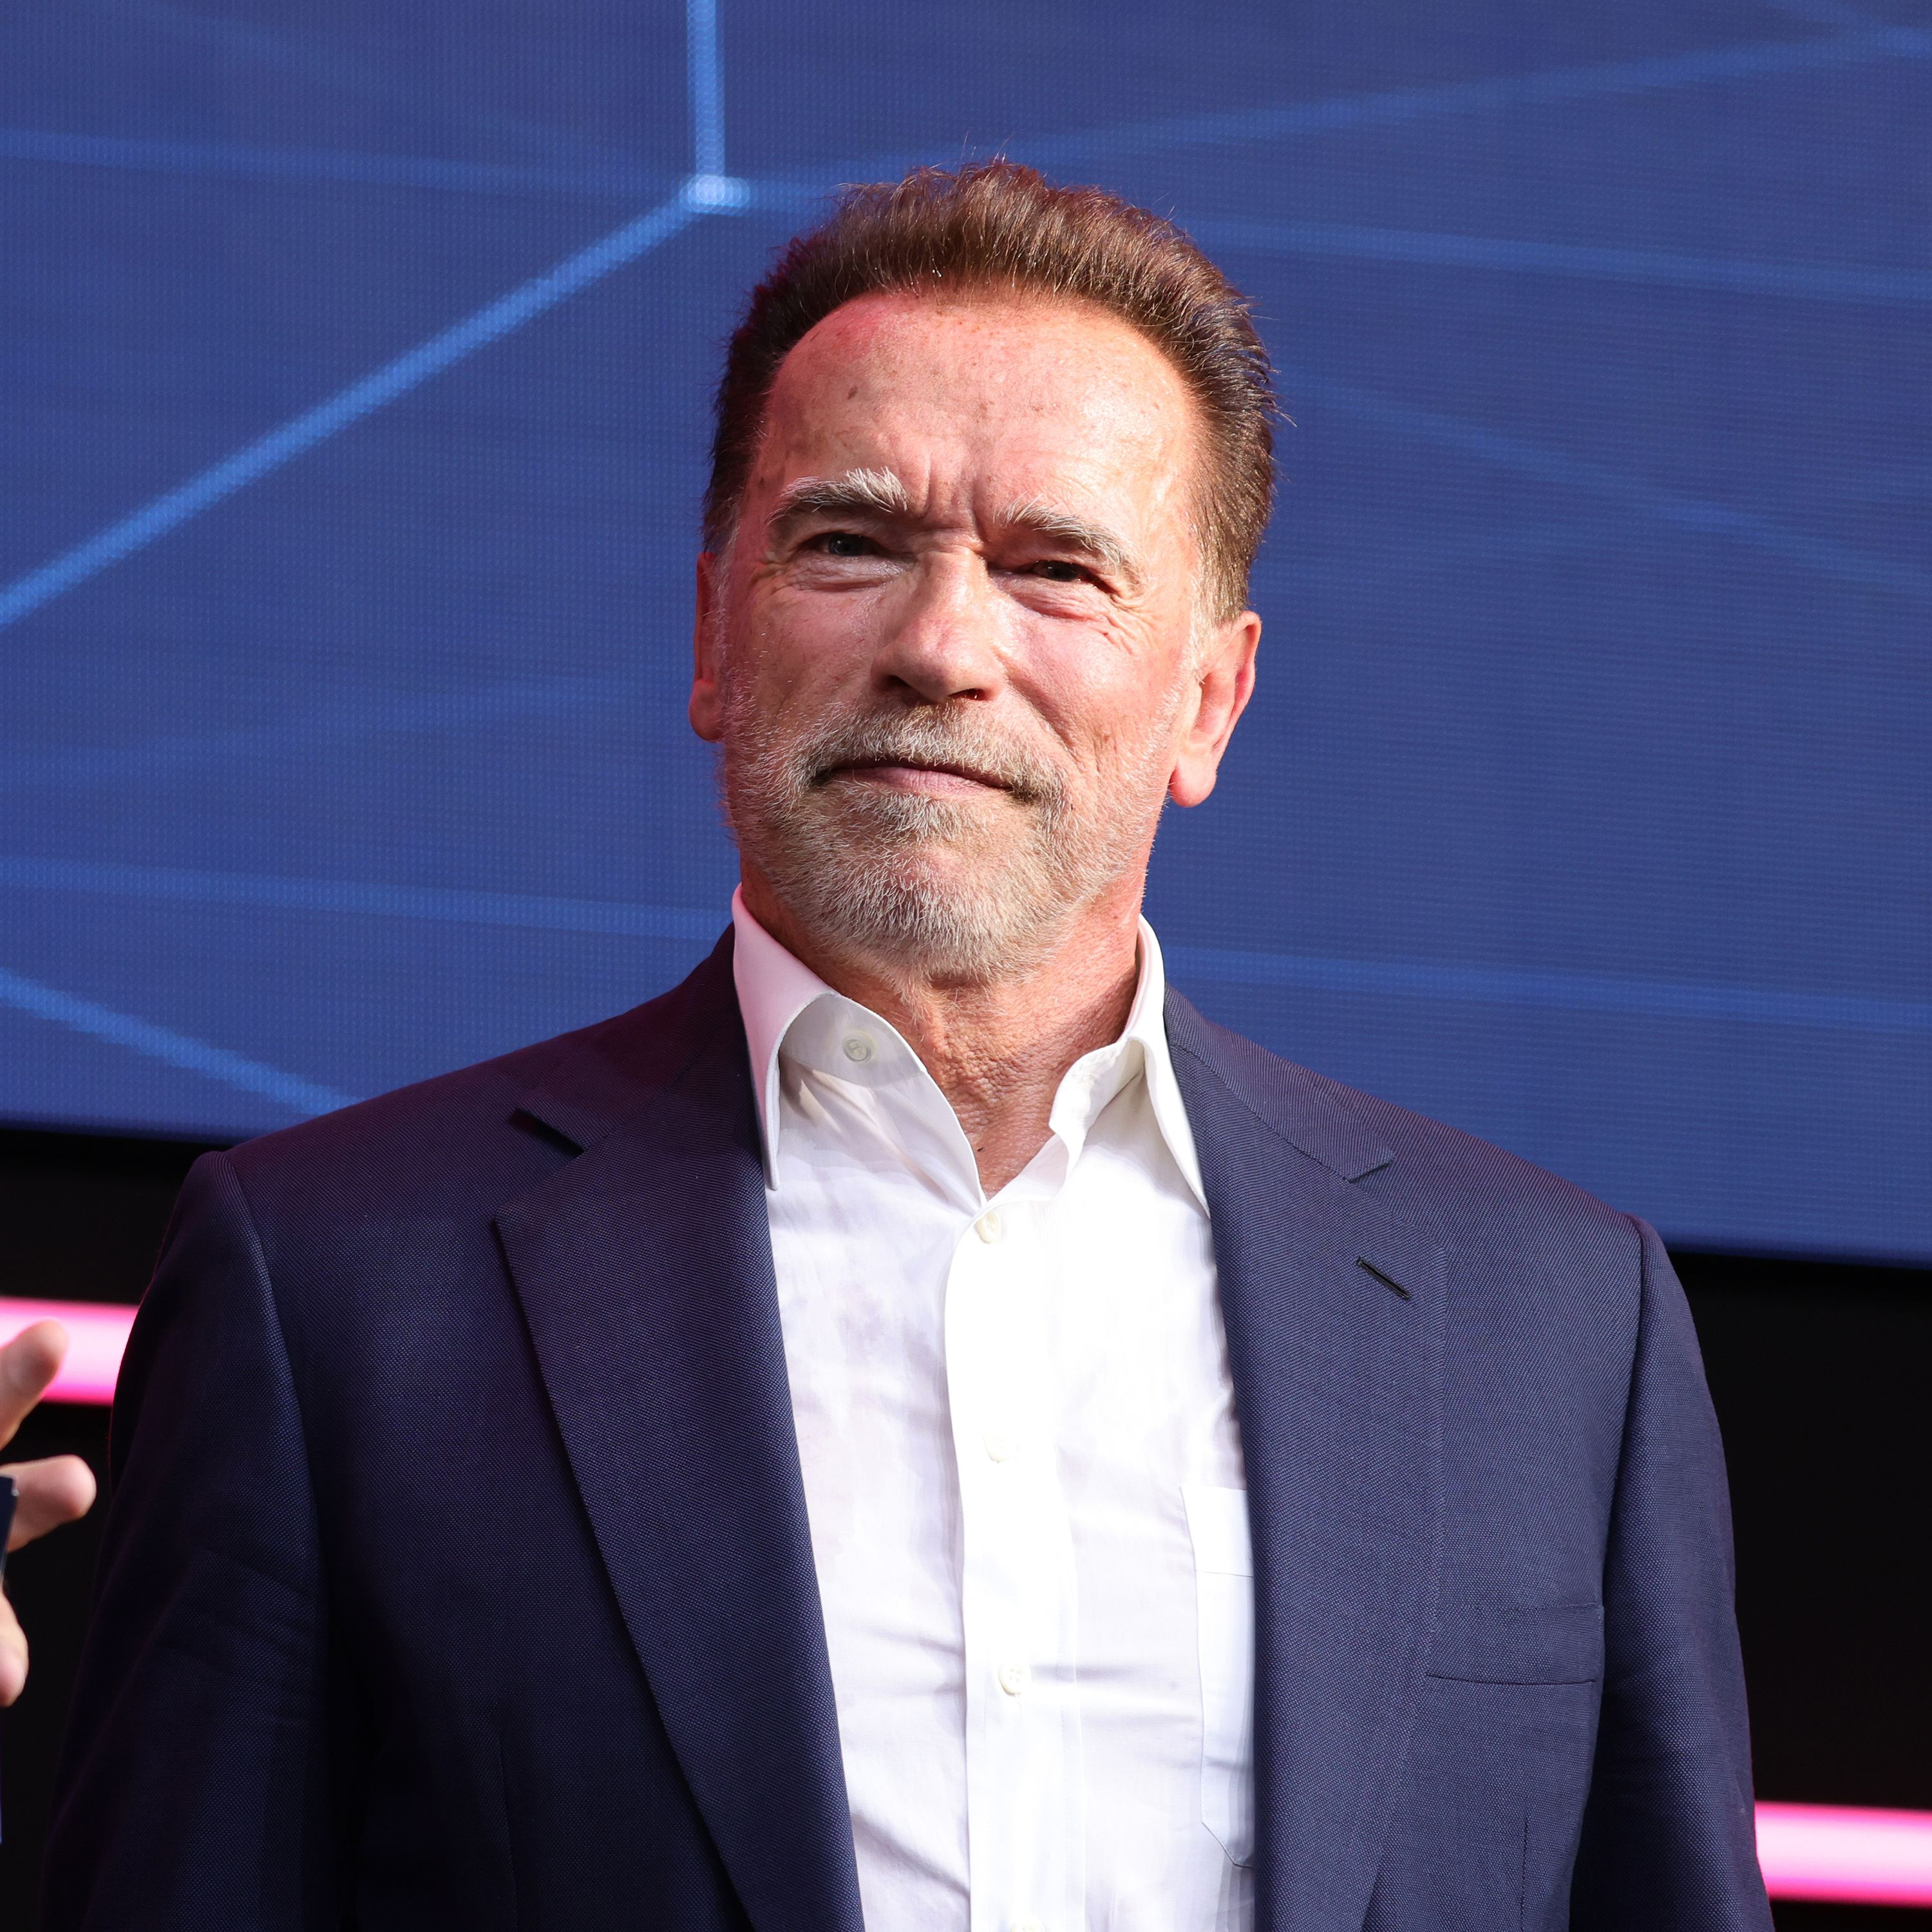
Personas
Barking App
Name | João
Gender | Male
Age | 28 years
Profession | Accountant
Background | João is a young adult who doesn’t have much experience with technology
Main motivation and goals | João, alongside his girlfriend, decided to live together and bring a new dog into the relationship
Needs | João doesn't have much experience with pets and doesn't know how to properly take care of one, so they need a trustwhorthy source to learn how to care of their dog
HCI 2023-2024
5

Slide 6
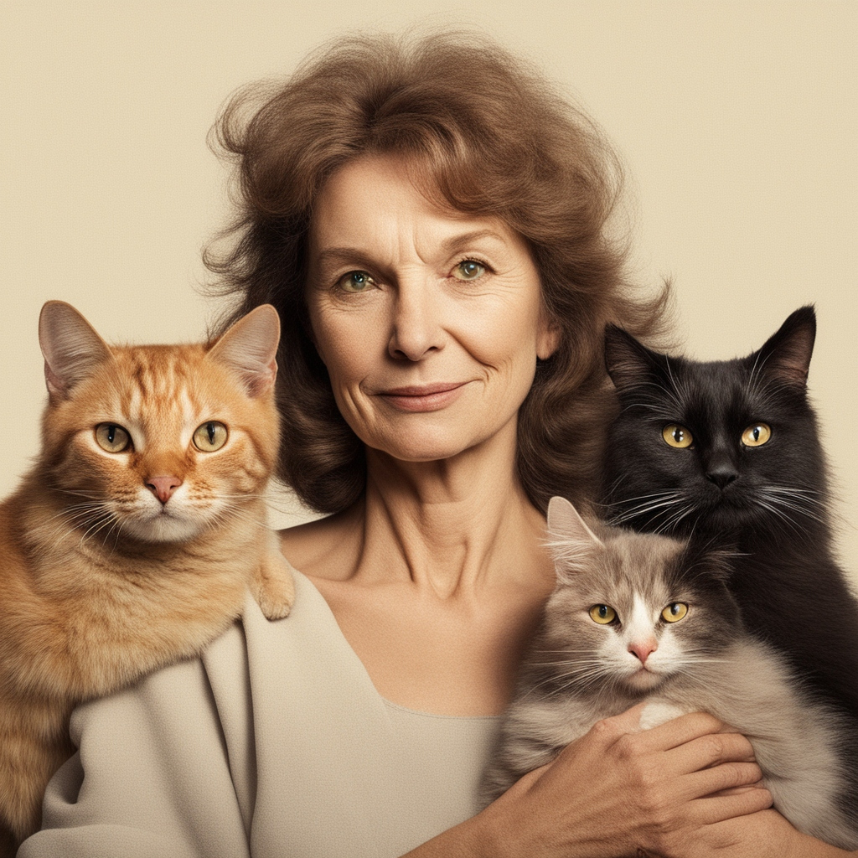
Personas
Barking App
Name | Matilda
Gender | Female
Age | 78 years
Profession | Janitress
Background | Matilda, although has almost no technology knowledge, is an expert in caring for animals
Main motivation and goals | Matilda has seven cats which require lots of attention and different needs
Needs | Matilda needs a reliable source to organize all the needs for each of her cat’s, whose healthcare differs greatly from eachother
HCI 2023-2024
6

Slide 7
Scenarios
Barking App
Task 1 - João wants to check the prescription the vet passed in the last appointment
João will open the application and click on the pet that had the appointment.
Then scroll to the appointments and click on the last appointment
Finally, check ‘Prescriptions’ where there will be a list of prescribed medications and information
Task 2 – Matilda wants to buy the recommended food for each of her 7 cats
During her shopping, Matilda will open the application and do the following steps for each of her cat:
Click on the desired pet and click on ‘Recommendations’ button
Check the food the vet advised to feed that cat specifically
Task 3 – Matilda wants to update one of her pet’s weight to update her vet
Matilda will open the application and select the relevant cat
Then select the option to add a new weighing
Add the updated mass of the cat to the app and submit
Finally, verify if the update was successful
HCI 2023-2024
7

Slide 8
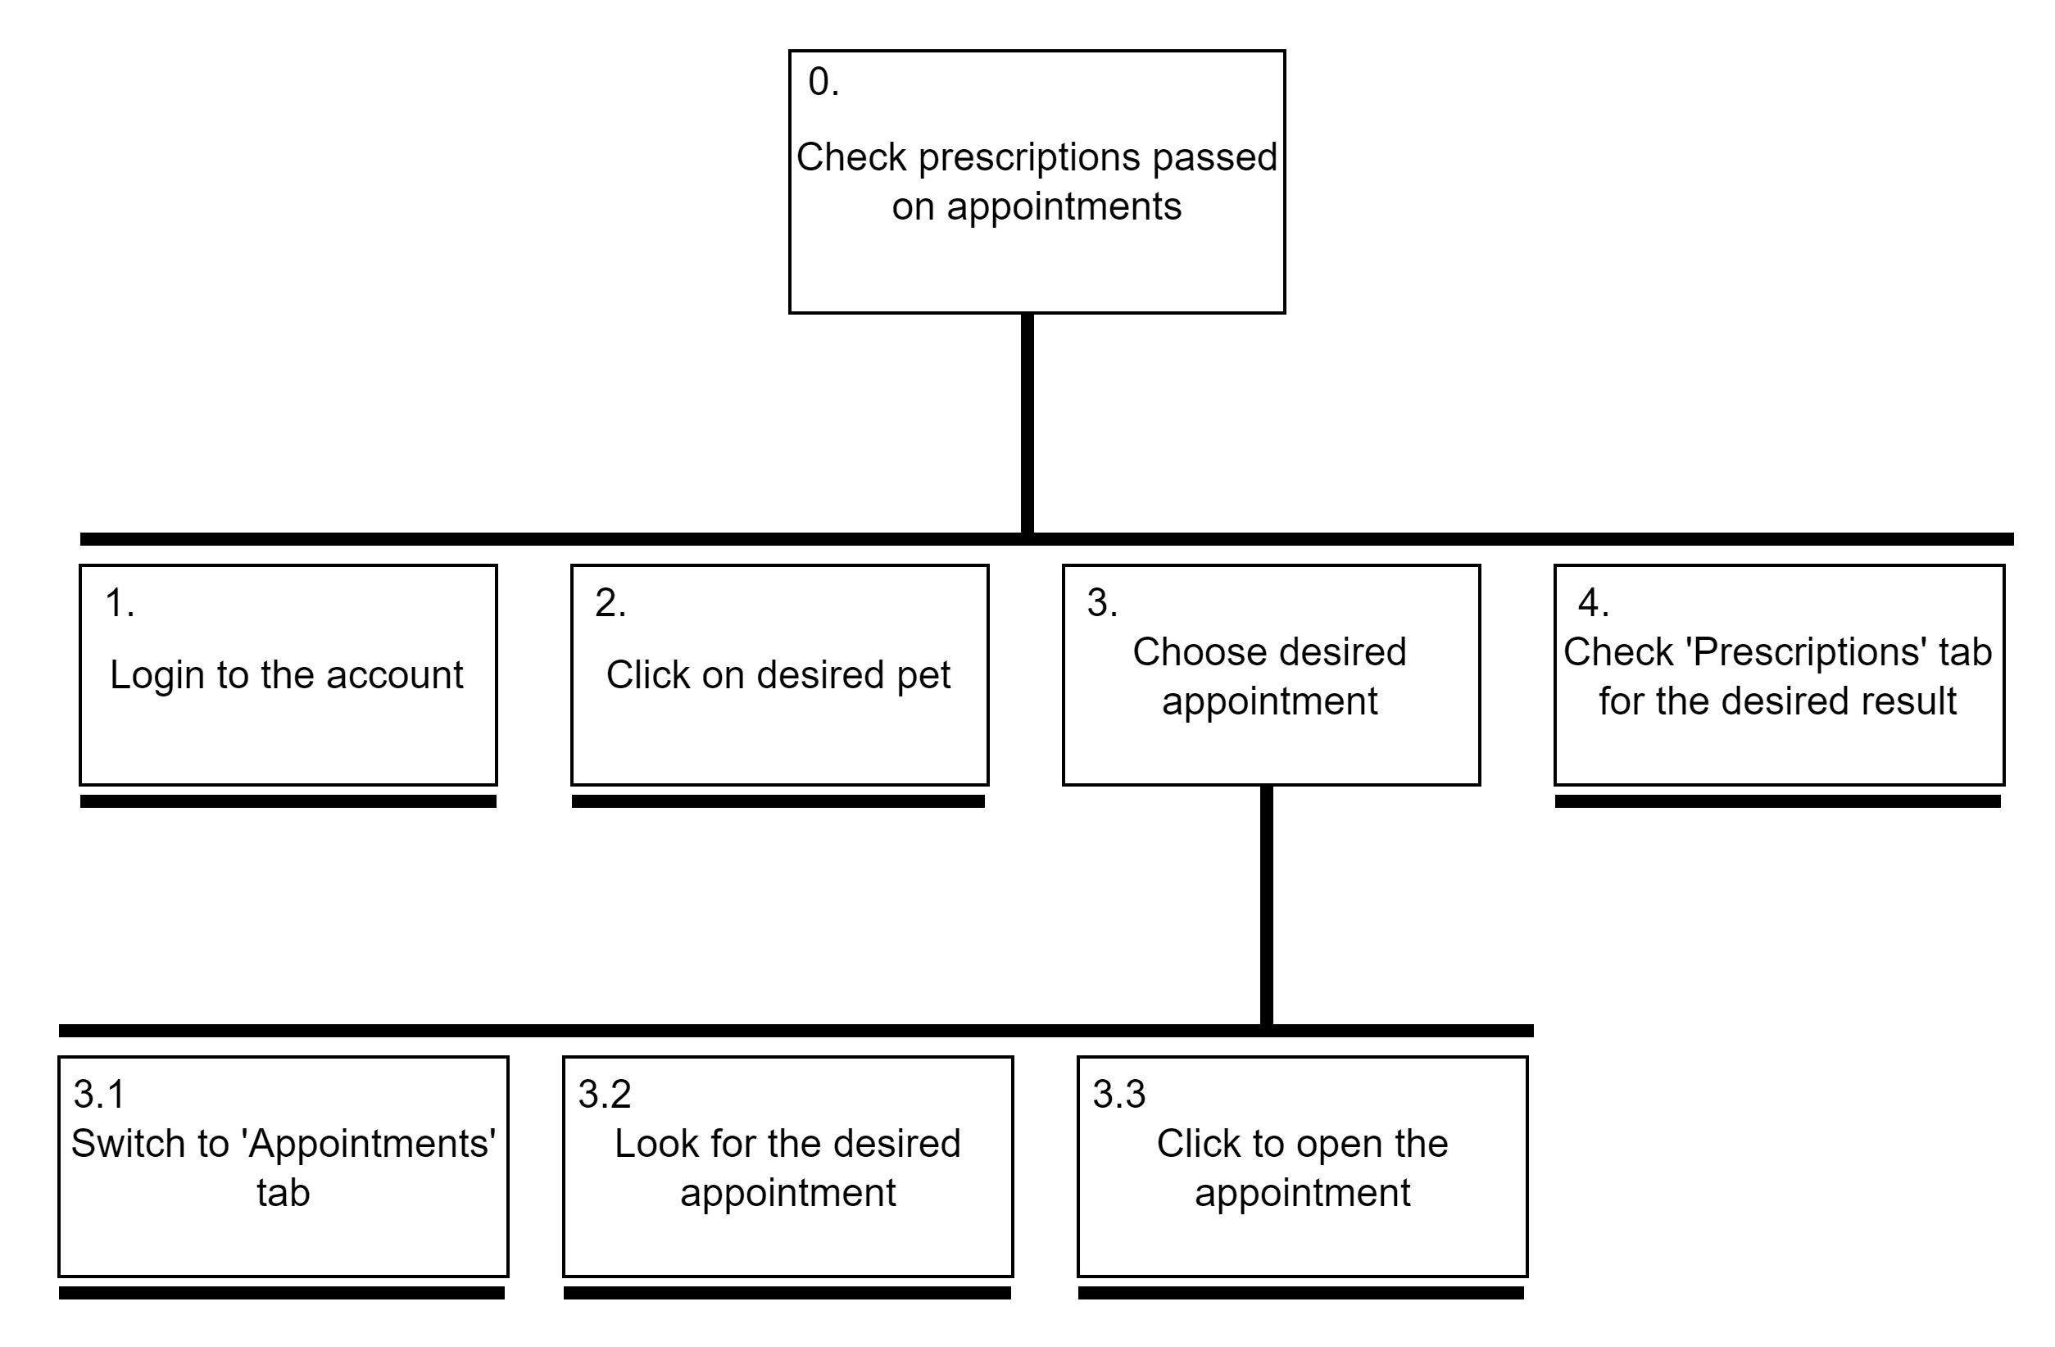
Task 1 – Check prescription
Barking App
HCI 2023-2024
8

Slide 9
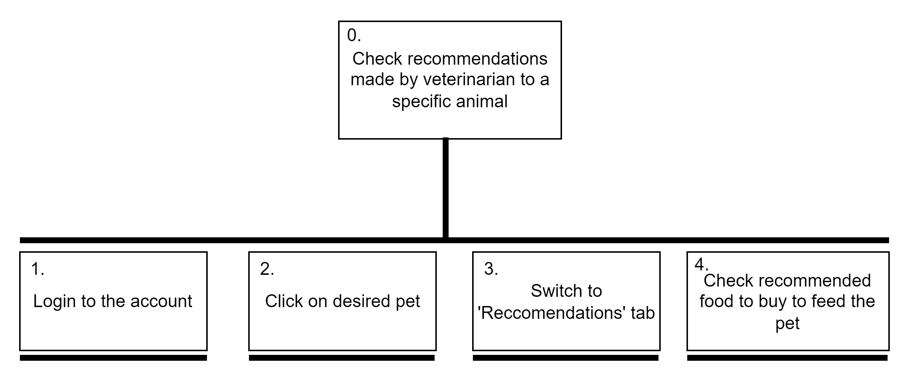
Task 2 – Check care recommendations
Barking App
HCI 2023-2024
9

Slide 10
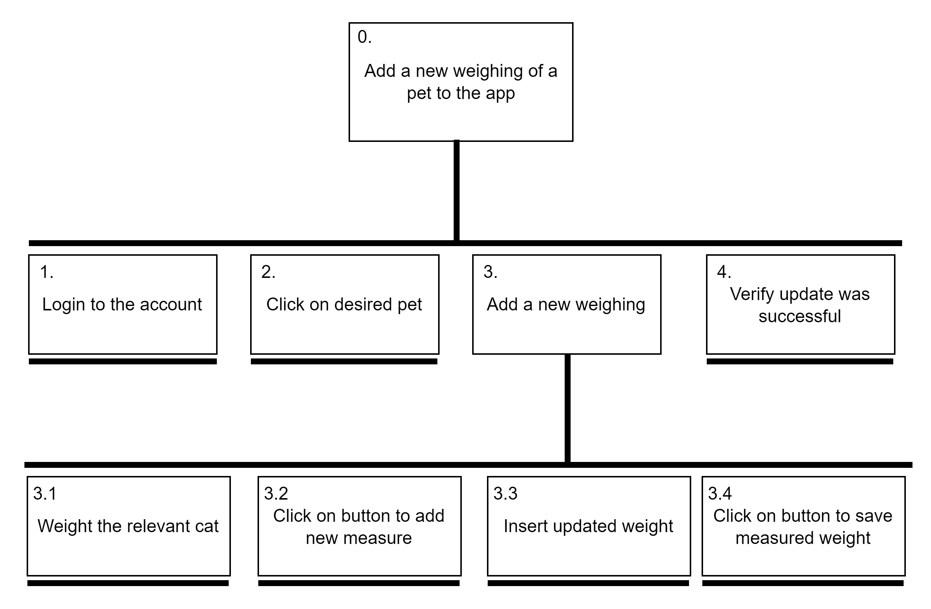
Task 3 – Update pet information
Barking App
HCI 2023-2024
10

Slide 11
Requirements
Barking App
NON-FUNCTIONAL REQUIREMENTS | FUNCTIONAL REQUIREMENTS
Focused on mobile users, to be used as an web app (responsive) Must have a considerable ease of use for a broad audience App elements should be intuitive both visually and usability-wise Efficient and low loading times to ensure a smooth usage of the app Tasks performed should have few steps to ensure simplicity | Access pet’s prescriptions and vaccinations Access pet’s registry and information Owner can add made-at-home measurements of their pets’ weight Check scheduled appointments and surgeries date and information Check information about previous visits Receive a notification when an order made previously arrives at the veterinarian Update info about medication / diet Chat section for the owner to clarify doubts with the vet
HCI 2023-2024
11

Slide 12
Next steps
Barking App
What type of prototype are you considering?
We intend on making a figma prototype.
How will you test it?
To make a viable prototype analysis, we will evaluate our work through Heuristic Evaluations alongside Cognitive Walkthroughs.
HCI 2023-2024
12

